Slide 1

Class 2 – Python Crash Course
Pedram Jahangiry
Fall 2019

Slide 2
Install Python with Anaconda
Anaconda:
A distribution of python
Includes Python and many other libraries
All-in-one install
Jupyter:
A development environment for writing code and markdown and display images
Most popular IDE
Best learning/teaching tool

Slide 3
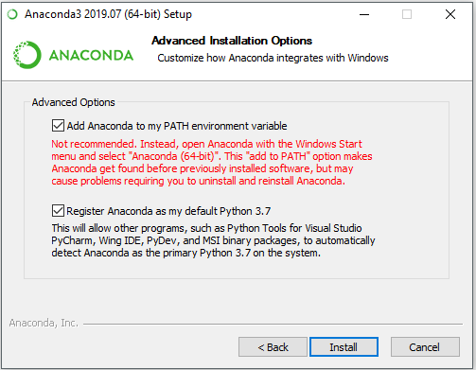
Install Python with Anaconda
https://www.anaconda.com/
Download the Graphical Installer
Make sure checking both boxes
Search for Anaconda Navigator

Slide 4
Data Science Libraries
Numpy:
A Linear Algebra library for python.
Very fast (binding to C libraries)
Building block of almost all of the libraries in the PyData ecosystem (Pandas, Scipy, Scikit-learn and etc).
Pandas:
A library built on top of Numpy.
Allows for fast analysis and data cleaning
Has built-in visualization features
To install any library:
conda install numpy
pip install numpy

Slide 5
Data Science Libraries
matplotlib:
Most popular plotting library for python.
Very similar to MATLAB's plotting.
seaborn:
A statistical plotting library
Built on top of matplotlib
To install any library:
conda install numpy
pip install numpy

